Slide 1
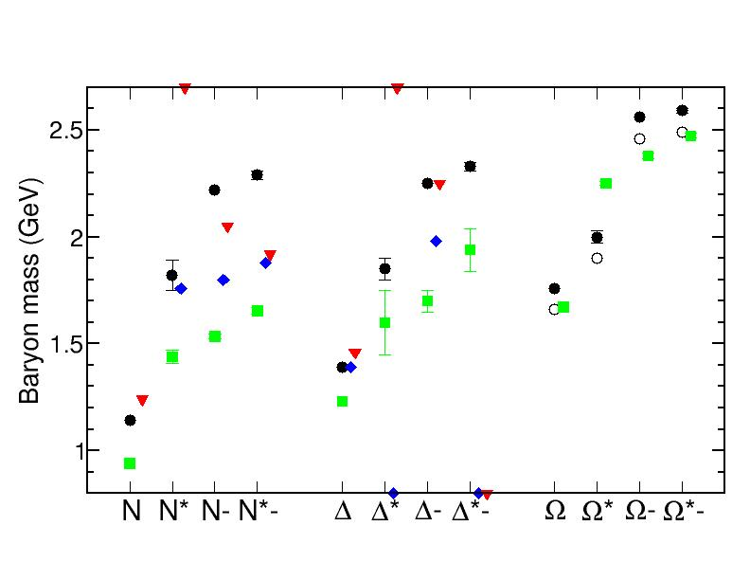
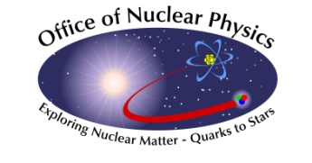
Dressed-quarks and the Roper Resonance
Craig Roberts
Physics Division
Masses of ground and excited-state hadrons Hannes L.L. Roberts, Lei Chang, Ian C. Cloët and Craig D. Roberts, arXiv:1101.4244 [nucl-th],
Few Body Syst. 51 (2011) pp. 1-25; DOI:10.1007/s00601-011-0225-x
Notes:
30mins=24+6

Slide 2
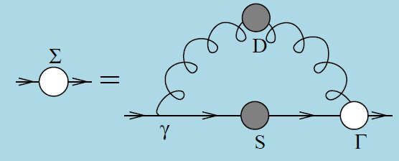
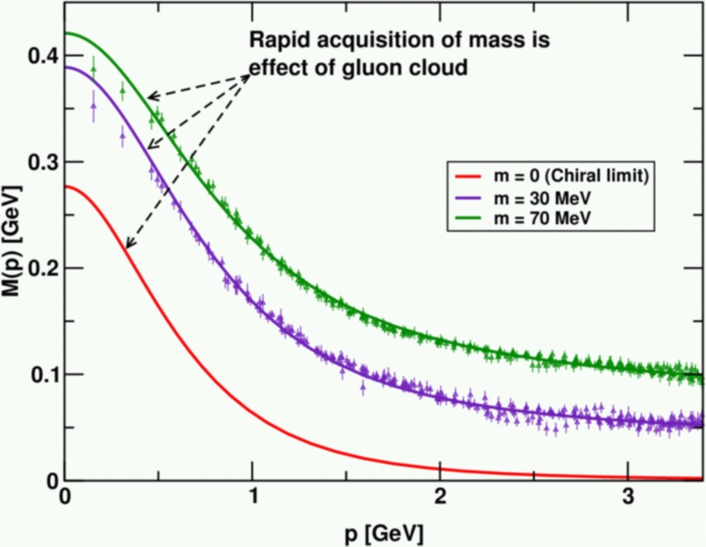
Frontiers of Nuclear Science: Theoretical Advances
In QCD a quark's effective mass depends on its momentum. The function describing this can be calculated and is depicted here. Numerical simulations of lattice QCD (data, at two different bare masses) have confirmed model predictions (solid curves) that the vast bulk of the constituent mass of a light quark comes from a cloud of gluons that are dragged along by the quark as it propagates. In this way, a quark that appears to be absolutely massless at high energies (m =0, red curve) acquires a large constituent mass at low energies.
Notes:
(20)

Slide 3
Frontiers of Nuclear Science: Theoretical Advances
In QCD a quark's effective mass depends on its momentum. The function describing this can be calculated and is depicted here. Numerical simulations of lattice QCD (data, at two different bare masses) have confirmed model predictions (solid curves) that the vast bulk of the constituent mass of a light quark comes from a cloud of gluons that are dragged along by the quark as it propagates. In this way, a quark that appears to be absolutely massless at high energies (m =0, red curve) acquires a large constituent mass at low energies.
Mass from nothing!
DSE prediction of DCSB confirmed

Slide 4
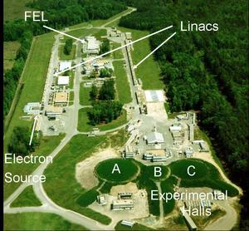
12GeV The Future of JLab
Numerical simulations of lattice QCD (data, at two different bare masses) have confirmed model predictions (solid curves) that the vast bulk of the constituent mass of a light quark comes from a cloud of gluons that are dragged along by the quark as it propagates. In this way, a quark that appears to be absolutely massless at high energies (m =0, red curve) acquires a large constituent mass at low energies.
Jlab 12GeV: Scanned by 2<Q²<9 GeV²
elastic & transition form factors.

Slide 5
Gap Equation General Form
D_{μν}(k) – dressed-gluon propagator
Γ_{ν}(q,p) – dressed-quark-gluon vertex
Suppose one has in hand – from anywhere – the exact form of the dressed-quark-gluon vertex
What is the associated symmetry-
preserving Bethe-Salpeter kernel?!

Slide 6
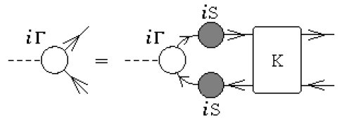
Bethe-Salpeter Equation Bound-State DSE
K(q,k;P) – fully amputated, two-particle irreducible,
quark-antiquark scattering kernel
Textbook material.
Compact. Visually appealing. Correct
Blocked progress for more than 60 years.

Slide 7
Bethe-Salpeter Equation General Form
Lei Chang and C.D. Roberts
0903.5461 [nucl-th]
Phys. Rev. Lett. 103 (2009) 081601
Equivalent exact bound-state equation but in this form
K(q,k;P) → Λ(q,k;P)
which is completely determined by dressed-quark self-energy
Enables derivation of a Ward-Takahashi identity for Λ(q,k;P)
Notes:
(30)

Slide 8
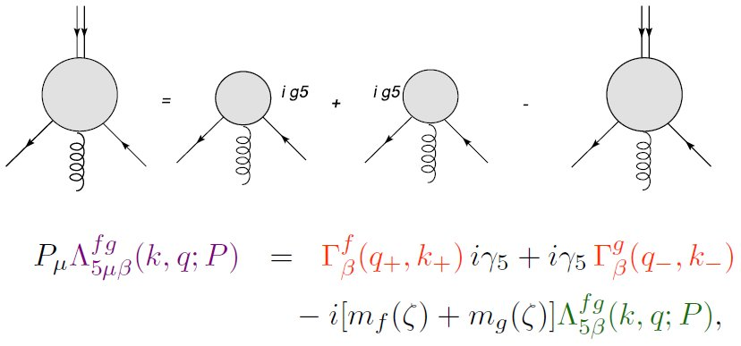
Ward-Takahashi Identity Bethe-Salpeter Kernel
Lei Chang and C.D. Roberts
0903.5461 [nucl-th]
Phys. Rev. Lett. 103 (2009) 081601
iγ₅
iγ₅
Now, for first time, it’s possible to formulate an Ansatz for
Bethe-Salpeter kernel given any form for the dressed-quark-gluon vertex by using this identity
This enables the identification and elucidation of a wide range of novel consequences of DCSB

Slide 9
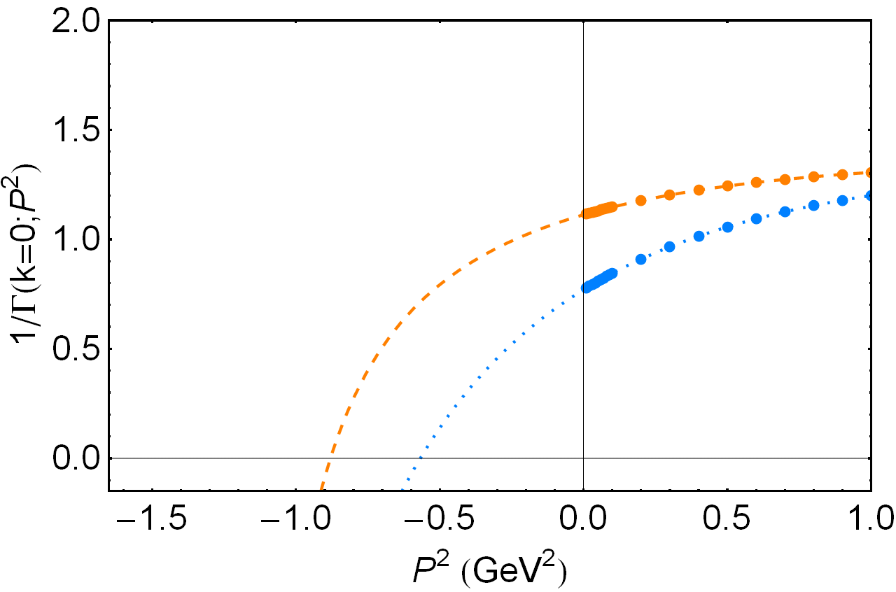
Dressed Vertex & Meson Spectrum
Location of zero
marks –m²_{meson}
 | Experiment | Rainbow-ladder | One-loop corrected | Ball-Chiu | Full vertex
a1 | 1230
ρ | 770
Mass splitting | 455
 | Experiment | Rainbow-ladder | One-loop corrected | Ball-Chiu | Full vertex
a1 | 1230 | 759 | 885
ρ | 770 | 644 | 764
Mass splitting | 455 | 115 | 121
Splitting known experimentally for more than 35 years
Hitherto, no explanation
Systematic symmetry-preserving, Poincaré-covariant DSE truncation scheme of nucl-th/9602012.
Never better than ∼ ⅟₄ of splitting
Constructing kernel skeleton-diagram-by-diagram,
DCSB cannot be faithfully expressed:
Full impact of M(p²)
cannot be realised!

Slide 10
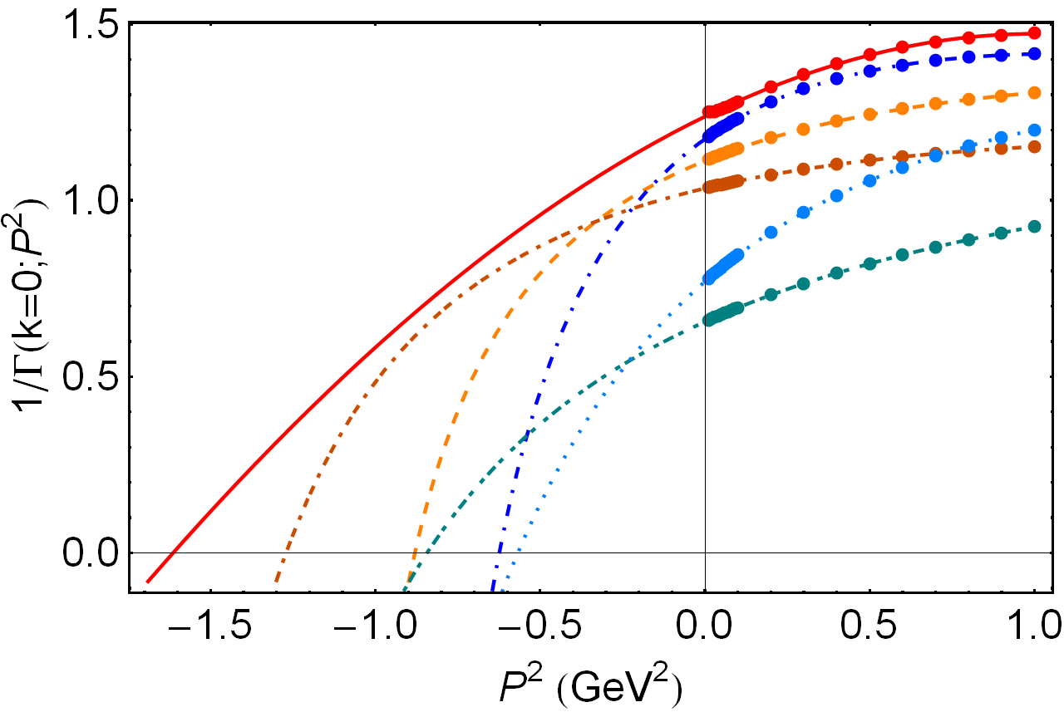
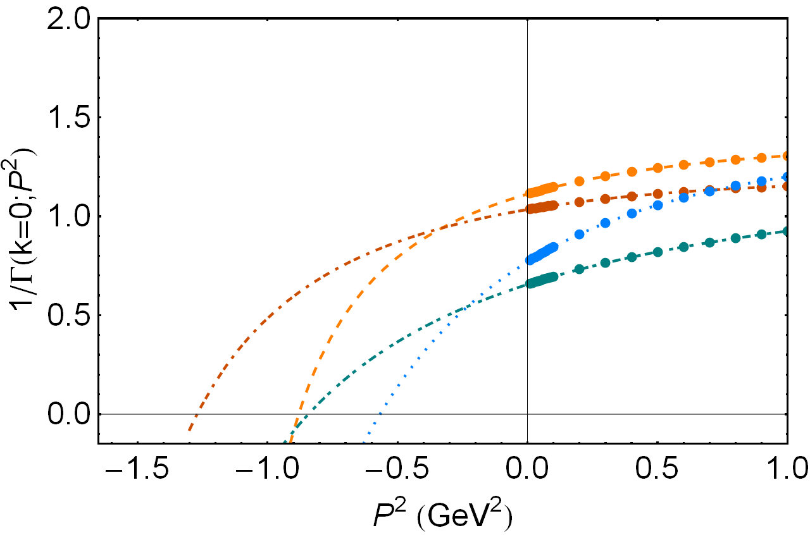
Dressed Vertex & Meson Spectrum
BC: zero moves deeper
for both ρ & a₁
Both masses grow
Full vertex:
zero moves deeper for a₁
but shallower for ρ
Problem solved
 | Experiment | Rainbow-ladder | One-loop corrected | Ball-Chiu | Full vertex
a1 | 1230 | 759 | 885 | 1066
ρ | 770 | 644 | 764 | 924
Mass splitting | 455 | 115 | 121 | 142
 | Experiment | Rainbow-ladder | One-loop corrected | Ball-Chiu | Full vertex
a1 | 1230 | 759 | 885 | 1128 | 1270
ρ | 770 | 644 | 764 | 919 | 790
Mass splitting | 455 | 115 | 121 | 209 | 480
Fully consistent treatment of Ball-Chiu vertex
Retain λ₃ – term but ignore Γ⁴ & Γ⁵
Some effects of DCSB built into vertex & Bethe-Salpeter kernel
Big impact on σ – π complex
But, clearly, not the complete answer.
Fully-consistent treatment of complete vertex Ansatz
Promise of 1st reliable prediction
of light-quark hadron spectrum
Lei Chang & C.D. Roberts,
arXiv:1104.4821 [nucl-th]
“Tracing massess of ground-state
light-quark mesons”

Slide 11
DSEs and Baryons
R.T. Cahill et al.,
Austral. J. Phys. 42 (1989) 129-145
Dynamical chiral symmetry breaking (DCSB)
– has enormous impact on meson properties.
Must be included in description and prediction of baryon properties.
DCSB is essentially a quantum field theoretical effect.
In quantum field theory
Meson appears as pole in four-point quark-antiquark Green function → Bethe-Salpeter Equation
Nucleon appears as a pole in a six-point quark Green function
→ Faddeev Equation.
Poincaré covariant Faddeev equation sums all possible exchanges and interactions that can take place between three dressed-quarks
Tractable equation is based on observation that an interaction which describes colour-singlet mesons also generates nonpointlike quark-quark (diquark) correlations in the colour-antitriplet channel
r_{qq} ≈ r_{π}

Slide 12
Faddeev Equation
R.T. Cahill et al.,
Austral. J. Phys. 42 (1989) 129-145
quark exchange
ensures Pauli statistics
quark
Linear, Homogeneous Matrix equation
Yields wave function (Poincaré Covariant Faddeev Amplitude) that describes quark-diquark relative motion within the nucleon
Scalar and Axial-Vector Diquarks . . .
Both have “correct” parity and “right” masses
In Nucleon’s Rest Frame Amplitude has
s−, p− & d−wave correlations
diquark

Slide 13
Unification of Meson & Baryon Spectra
Correlate the masses of meson and baryon ground- and excited-states within a single, symmetry-preserving framework
Symmetry-preserving means:
Poincaré-covariant & satisfy relevant Ward-Takahashi identities
Constituent-quark model has hitherto been the most widely applied spectroscopic tool; and whilst its weaknesses are emphasized by critics and acknowledged by proponents, it is of continuing value because there is nothing better that is yet providing a bigger picture.
Nevertheless,
no connection with quantum field theory & certainly not with QCD
not symmetry-preserving & therefore cannot veraciously connect meson and baryon properties

Slide 14
Diquarks
Calculation of diquark masses in QCD
R.T. Cahill, C.D. Roberts and J. Praschifka
Phys.Rev. D36 (1987) 2804
Rainbow-ladder gap and Bethe-Salpeter equations
In this truncation, colour-antitriplet quark-quark correlations (diquarks) are described by a very similar homogeneous Bethe-Salpeter equation
Only difference is factor of ½
Hence, an interaction that describes mesons also generates diquark correlations in the colour-antitriplet channel

Slide 15
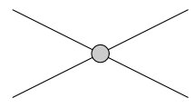
Interaction Kernel
Vector-vector contact interaction
m_{G} is a gluon mass-scale – dynamically generated in QCD, model parameter here
Gap equation:
DCSB: M ≠ 0 is possible so long as m_{G}<m_{G}^{critical}
Studies of π & ρ static properties and form factors (arXiv:1102.4376) establish that contact-interaction results are not distinguishable from those of renormalisation-group-improved one-gluon exchange for Q²<M²

Slide 16
Meson Spectrum -Ground-states
Ground-state masses
Computed very often in rainbow-ladder truncation,
always with same result
Namely, with rainbow-ladder truncation
m_{a1} – m_{ρ} = 0.15 GeV ≈ ⅟₃ ^{x} 0.45_{experiment}
But, we know how to fix that viz.,
DCSB – beyond rainbow ladder
increases scalar and axial-vector masses
leaves π & ρ unchanged
 | Experiment | Rainbow-ladder | One-loop corrected | Ball-Chiu | Full vertex
a1 | 1230 | 759 | 885 | 1128 | 1270
ρ | 770 | 644 | 764 | 919 | 790
Mass splitting | 455 | 115 | 121 | 209 | 480

Slide 17
Meson Spectrum -Ground-states
Ground-state masses
Correct for omission of
DCSB-induced spin-orbit repulsion
Leave π- & ρ-meson BSEs unchanged but introduce repulsion parameter in scalar and axial-vector channels; viz.,
g_{SO}=0.24 fitted to produce m_{a1} – m_{ρ} = 0.45_{experiment}
m_{σ}^{qq} ≈ 1.2 GeV is location of
quark core of σ-resonance:
Pelaez & Rios (2006)
Ruiz de Elvira, Pelaez,
Pennington & Wilson (2010)
EBAC – in progress
First novel post-diction

Slide 18
Meson Spectrum Ground- & Excited-States
plus predicted
diquark spectrum
Complete the table …
rms-relative-error/degree-of-freedom = 13%
No parameters
Realistic DSE estimates: m₀₊=0.7-0.8, m₁₊=0.9-1.0
Lattice-QCD estimate: m₀₊=0.78 ±0.15, m₁₊-m₀₊=0.14
FIRST results for other
qq quantum numbers
Critical for excited
states of N and Δ

Slide 19
Spectrum of Baryons
Variant of:
A. Buck, R. Alkofer & H. Reinhardt,
Phys. Lett. B286 (1992) 29.
Static “approximation”
Implements analogue of contact interaction in Faddeev-equation
In combination with contact-interaction diquark-correlations, generates Faddeev equation kernels which themselves are momentum-independent
The merit of this truncation is the dramatic simplifications which it produces
Used widely in hadron physics phenomenology; e.g., Bentz, Cloët, Thomas et al.

Slide 20
Spectrum of Baryons
Faddeev equation for Δ-resonance
One-dimensional eigenvalue problem, to which only axial-vector diquark contributes
Nucleon has scalar & axial-vector diquarks. It is a three-dimensional eigenvalue problem

Slide 21
Spectrum of Baryons “pion cloud”
Pseudoscalar-meson loop-corrections to our truncated DSE kernels
may have a material impact on m_{N} and m_{Δ} separately but the contribution to each is approximately the same
so that the mass-difference is largely unaffected by such corrections: (m_{Δ}- m_{N})_{π-loops}= 40MeV
EBAC: “undressed Δ” has m_{Δ} = 1.39GeV;
(m_{Δ}- m_{N})_{qqq-core}= 250MeV
achieved with g_{N}=1.18 & g_{Δ}=1.56
All three spectrum parameters now fixed (g_{SO}=0.24)

Slide 22
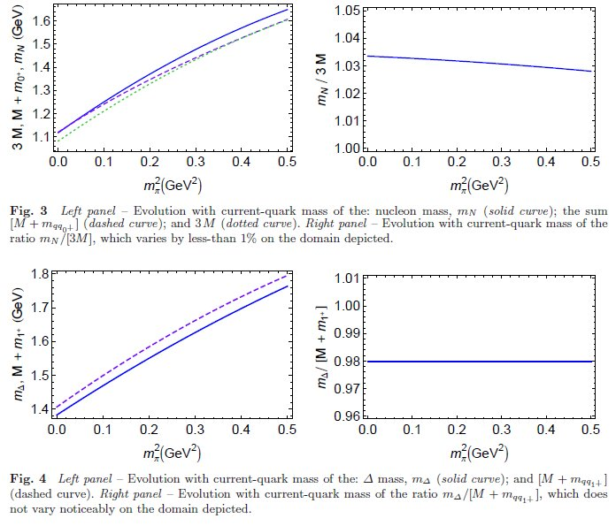
Baryons & diquarks
Provided numerous insights into baryon structure; e.g.,
m_{N} ≈ 3 M & m_{Δ} ≈ M+m₁₊

Slide 23
Baryon Spectrum
Masses of ground and excited-state hadrons Hannes L.L. Roberts, Lei Chang, Ian C. Cloët
and Craig D. Roberts, arXiv:1101.4244 [nucl-th]
Few Body Systems (2011) pp. 1-25
diquark content
Fascinating suggestion:
nucleon’s first excited state = almost entirely axial-vector diquark,
despite the dominance of scalar diquark in ground state
0⁺ | 77%
1⁺ | 23% | 100% |  |  | 100% | 100%
0⁻ |  |  | 51%
1⁻ |  |  | 49% | 100% |  |  | 100% | 100%

Slide 24
Baryon Spectrum
Masses of ground and excited-state hadrons Hannes L.L. Roberts, Lei Chang, Ian C. Cloët and Craig D. Roberts arXiv:1101.4244 [nucl-th] , to appear in Few Body Systems
Our predictions for baryon dressed-quark-core masses match the bare-masses determined by Jülich with a rms-relative-error of 10%.
Notably, however, we find a quark-core to the Roper resonance, whereas within the Jülich coupled-channels model this structure in the P₁₁ partial wave is unconnected with a bare three-quark state.

Slide 25
Baryon Spectrum
Masses of ground and excited-state hadrons Hannes L.L. Roberts, Lei Chang, Ian C. Cloët and Craig D. Roberts arXiv:1101.4244 [nucl-th] , to appear in Few Body Systems
In connection with EBAC's analysis, our predictions for the bare-masses agree within a rms-relative-error of 14%.
Notably, EBAC does find a dressed-quark-core for the Roper resonance, at a mass which agrees with our prediction.

Slide 26
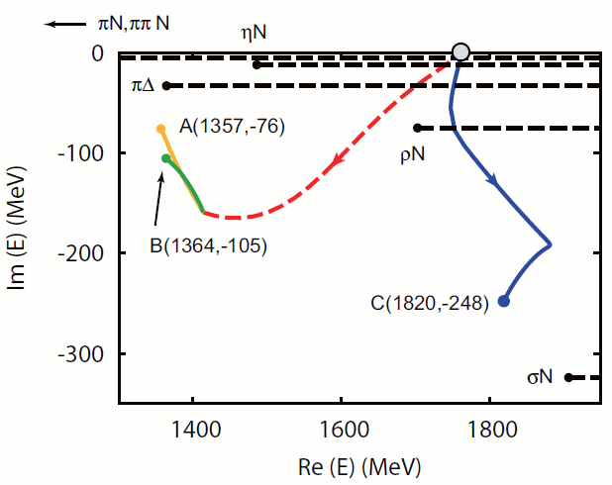
EBAC & the Roper resonance
N. Suzuki et al., Phys.Rev.Lett. 104 (2010) 042302
EBAC examined the dynamical origins of the two poles associated with the Roper resonance are examined.
Both of them, together with the next higher resonance in the P₁₁ partial wave were found to have the same originating bare state
Coupling to the meson-baryon continuum induces multiple observed resonances from the same bare state.
All PDG identified resonances consist of a core state and meson-baryon components.

Slide 27
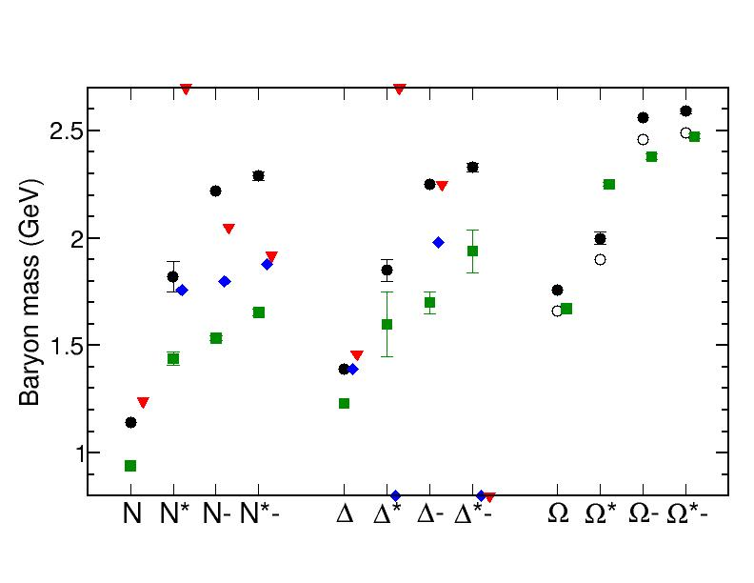
Hadron Spectrum
Legend:
Particle Data Group
H.L.L. Roberts et al.
EBAC
Jülich
Symmetry-preserving unification
of the computation of meson & baryon masses
rms-rel.err./deg-of-freedom = 13%
PDG values (almost) uniformly overestimated in both cases
- room for the pseudoscalar meson cloud?!

